Slide 1
Tools used in Analytics
Divya Choudhary

Slide 2
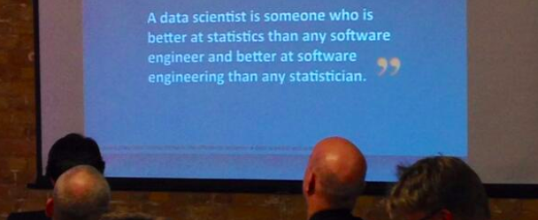
DATA ANALYST
DATA SCIENTIST
DATA ENGINEER
STATISTICIAN
SOFTWARE ENGINEER

Slide 3
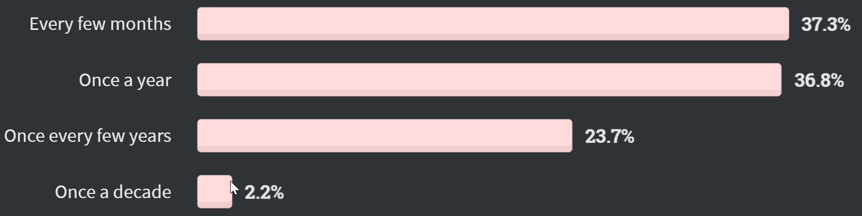
How often do you learn new technologies?
Source: https://insights.stackoverflow.com/survey/2020
Notes:
Coding is good –
Ask the MBA students about how often they learn new tech?
Mention about learning big data for the first time during this semester through this webinar
A few lines of code can do wonders
I’m sure you’ve learnt a lot of things in last few days. This is the trend

Slide 4
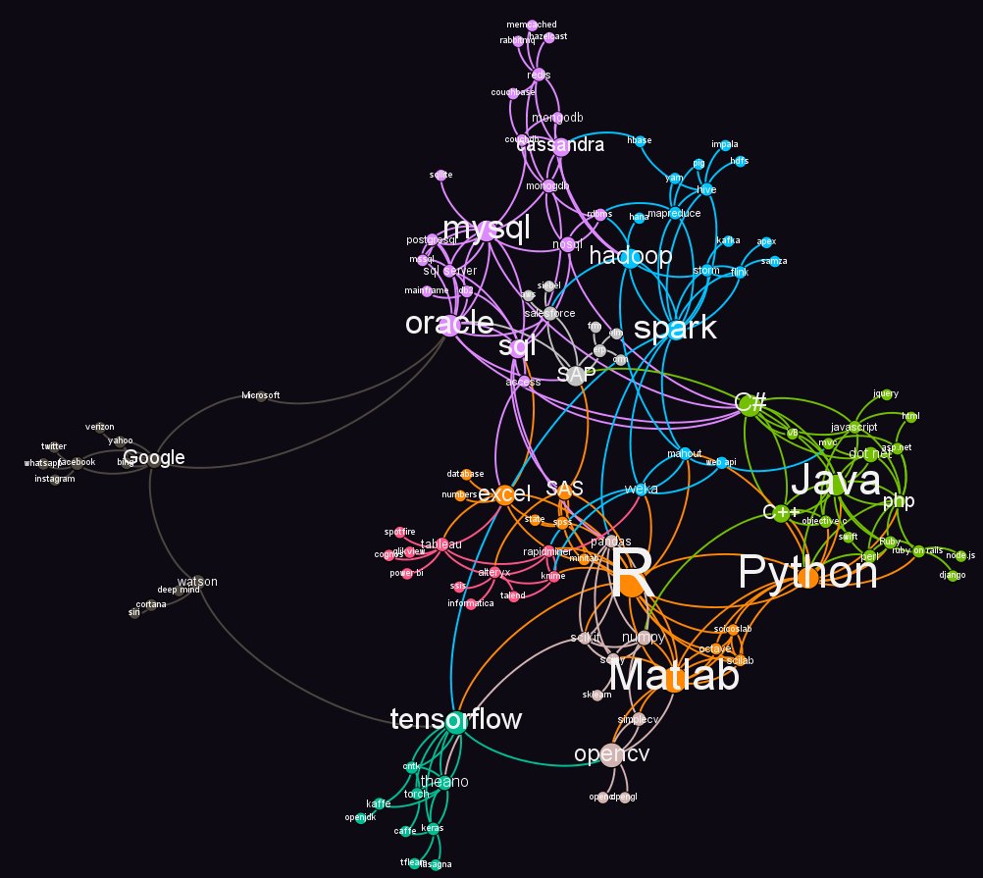
Data Science Ecosystem
Programming Language
Computational Framework
Big Data technology
Database
Visualization
AI products
Social media data source
Collaboration Tools
Source:
Dr. Archisman Majumdar, 2018
https://www.datasciencecentral.com/profiles/blogs/the-data-science-ecosystem-r-vs-python-vs-substitutes

Slide 5
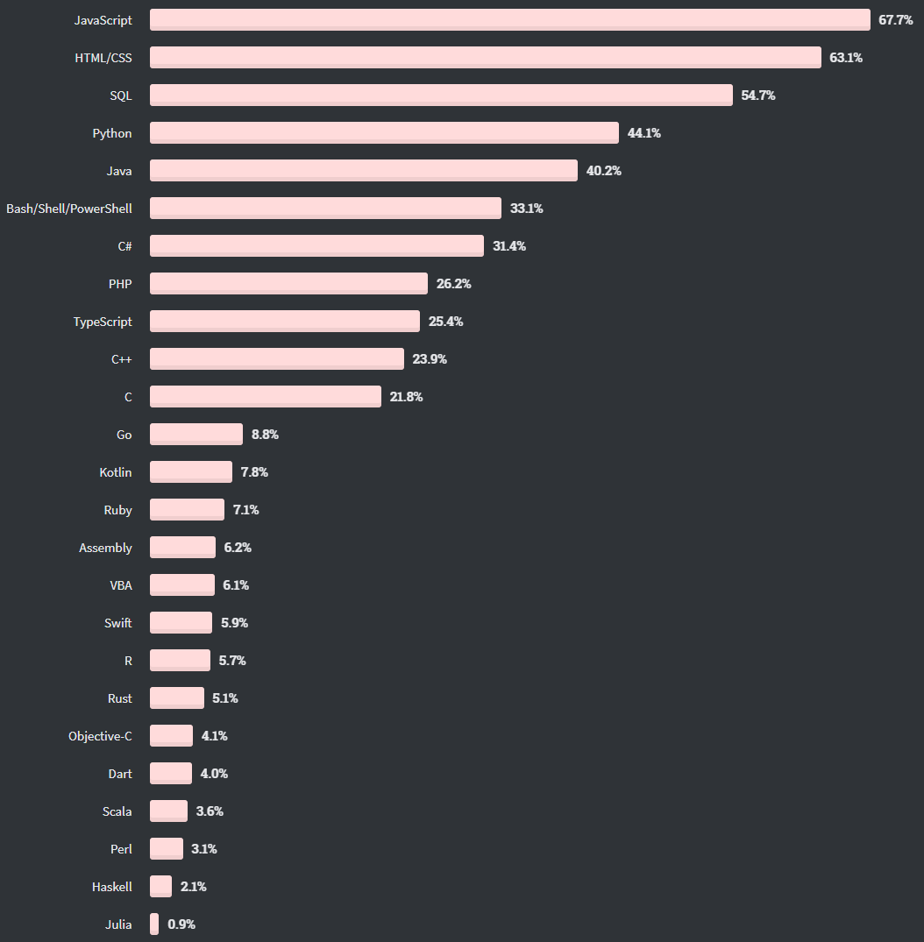
Most popular programming languages

Slide 6



Python – Jupyter – Spyder
Jupyter (supports Julia, Python, and R)
Interactive programming environment
Can share code + outputs
Ships with Anaconda with pre installed libraries
Familiarize with shortcuts
Jupyter vs Spyder (Demo)
Good for collaboration between Data and Business experts
Notes:
Talk for 5 mins on How options/convenience can be given to business users, non-programmer analysts to play with the model and change the results using options like user parameters.
Open a Jupyter/Spyder and show the features - 5 mins

Slide 7
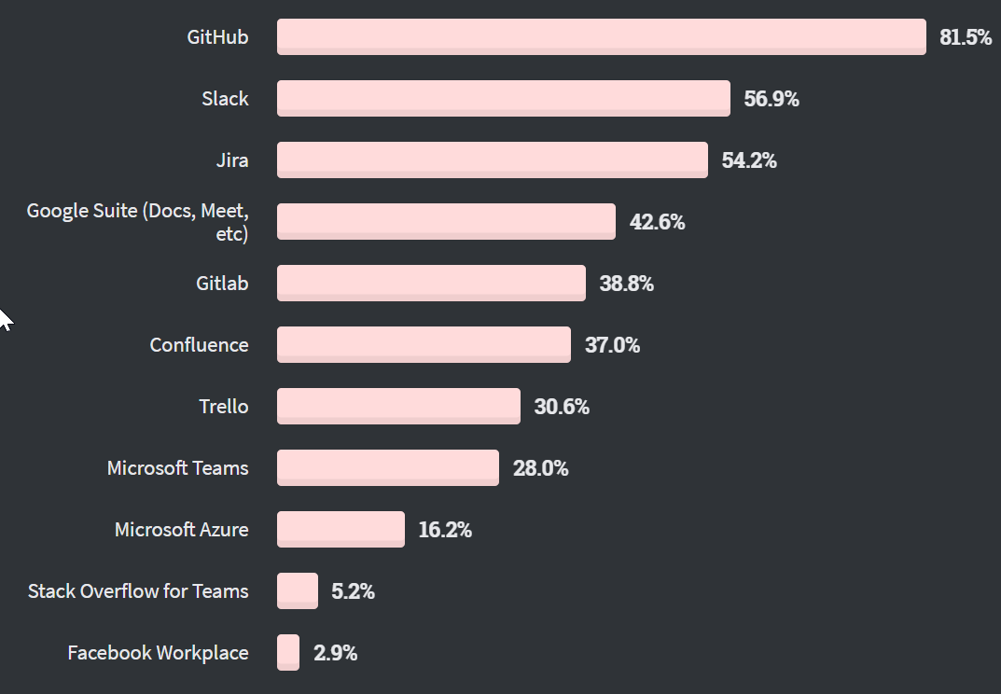
Collaboration tools
Version control
Any file storage
Access other’s work
Raise issues
Ask for help
Contribute to open source
https://github.com/microsoft/Bringing-Old-Photos-Back-to-Life
https://github.com/microsoft/Bing-COVID-19-Data
Notes:
Open famous/Official github pages from top known companies who made their github open to public in the data science areas.
Open GitHUb - 5 mins
https://github.com/microsoft/Bringing-Old-Photos-Back-to-Life
https://github.com/microsoft/Bing-COVID-19-Data

Slide 8
PySpark
Python wrapper over Spark
Used for parallelizing code
Functional code is easily parallelized
Supports Lazy execution

Slide 9
Demo
Github + Jupyter + PySpark
Notes:
LIVE demo - 8 mins

Slide 10
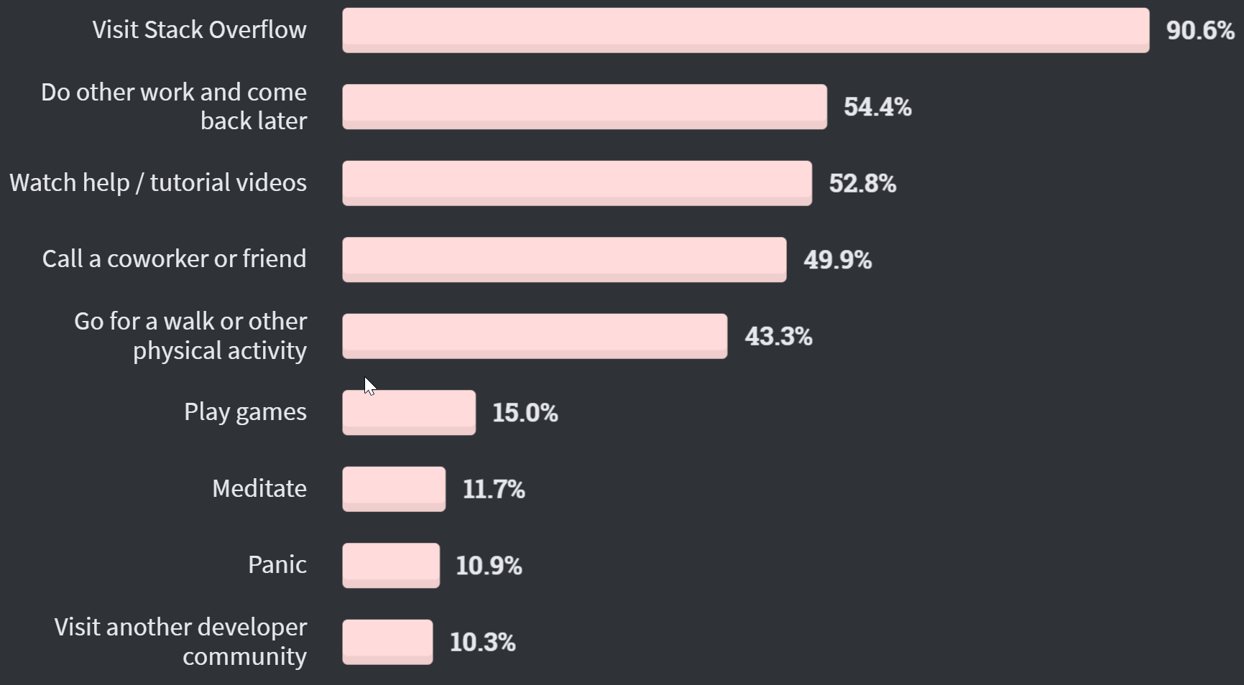
What do you do when you get stuck?
Notes:
Explore- stackoverflow - 5 mins
Goto my own posted questions

Slide 11
Thank You

